Slide 1
London Insurance Market
Lunch & Learn, Date: 15 December 2020
Presenters: Peter Dixon & Gary Millard

Slide 2
London Insurance Market
What does the London Insurance Market Consist of?
The London Market is a distinct, separate part of the UK insurance and reinsurance industry centred in the City of London. Its main participants are insurance and reinsurance companies, Lloyd's of London syndicates, Marine Protection and Indemnity Clubs (P&I Clubs), and brokers who handle most of the business.
The core of its activity is the conduct of internationally traded insurance and reinsurance business. This is mostly non-life insurance and reinsurance, particularly marine and aviation business, with an increasing emphasis on high-exposure risks.
Typically, Lloyd's business consists of international exposures, reinsurance, large and/or speciality risks that are not suited to the traditional insurance markets.
Notes:
Lloyds and the London Market are specialist markets underwriting large commercial, marine, energy and other insurances.
Situated in the Square Mile with a focus on Lime Street, Fenchurch Street and Leadenhall Street it is a center for insurance. The traditional placing process involves face to face negotiation so the close proximity of Lloyd’s and the London Underwriting Center to the London Market broking community facilitates the placing of large risks which are mainly done on a subscription basis – several syndicates and insurers need to accept the policy for the total values at risk to be covered.
There is another area of the London Insurance Market that we will not be covering as part of this presentation. Protection and Indemnity Clubs provide marine cover to shop owners and operators.

Slide 3
LLOYD’S OF LONDON

Slide 4
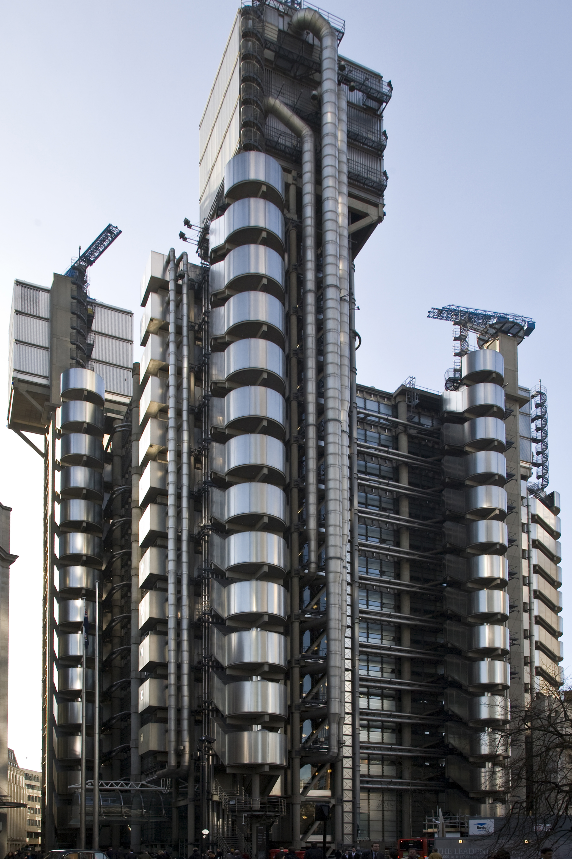
Lloyd's of London
What is Lloyd's
Lloyd’s of London is not an insurance company, but an insurance market of members, both corporate and individual.
Lloyd’s members conduct their insurance business in syndicates, each of which is run by a managing agent.
Over the course of its history, Lloyd’s has built a reputation for developing innovative coverages for the U.S. market including excess of loss reinsurance, kidnap and ransom insurance and more recently, terrorism insurance.
Whilst the mainstay of the Lloyd’s market is liability, marine and energy risks, Lloyd’s has been know to insure some peculiar items for example; Betty Grable’s legs, Merv Hughes’ moustache, Tom Jones’ chest hair, etc.
Some risks have huge values at risk, aircraft fleets and oil rigs are some examples.
Many policies are underwritten at Lloyd’s because of the breadth of experience in the Lloyd’s market that is not available elsewhere.
Notes:
Many people see the Lloyd’s building and think of Lloyd’s as an insurer. It’s not. Lloyd’s is the oversight and management (by which I mean regulatory management) organisation of multiple insurance entities, or syndicates. Think of Eastenders and the individual stalls in the street market. So when people say “Insured at Lloyd’s” it’s not quite correct; the insurance is with one or more syndicates who are members of Lloyd’s.
We will introduce some terms that are specific to Lloyd’s in a couple of slides. If you think about the market stall analogy then you have the managing agent who does the actual selling on the stall, the underwriters that set the prices and the names who provide the funds that are used to purchase the goods that are for sale on the stall.
Talk about some of the types of insurance provided. – see the 3rd paragraph
Aircraft at $150m each and x in a fleet.
Lloyd’s breadth of experience which is not available elsewhere.

Slide 5
Lloyd's of London
Business & Capital Flows
CORPORATION OF LLOYD’S
Managing Agents
Syndicates
THE MARKET
POLICYHOLDERS
DISTRIBUTION CHANNEL
Brokers
Coverholders
Service Companies
MEMBERS
< Corporate
< Non-Corporate
(Via Members Agents)
BUSINESS FLOW
CAPITAL FLOW
Lloyd’s is a partially mutualised market where members join together to form syndicates that insure risks.
Members can either be Corporate e.g., Plc companies, or Non-Corporate e.g., individual named investors (Names).
Much of Lloyd’s business is written on a subscription basis with more than one syndicate taking a share of the same risk.
Notes:
In order to understand how Lloyd’s functions consider the flow of business and capital into the market.
Policyholders will contact a broker, (I’ll explain what coverholders and service companies are later).
The broker gathers information regarding the policyholder’s requirements and presents it to underwriters in the market.
The underwriter will either accept or decline the risk and if accepting will indicate the percentage of the risk they are prepared to underwrite
To support the underwriting of the policy, capital is required to back the risk presented. That capital is provided by the members at Lloyd’s
Originally all capital was provided by wealthy individuals known as “Names” but now capital can come from corporate bodies (Plc’s) or from non corporate bodies – individual members introduced via a members agent

Slide 6
Lloyd's of London
How did Lloyd's come about?
1688 – First mention of Lloyd's
1730’s – Lloyd's begins to dominate marine insurance
1773 – Concept of Lead and Follow created
1811 – Creation of Lloyd’s Agency
1858 – Lutene Bell salvaged and installed in Lloyd’s
1870 – Large Syndicates introduced
1871 – First Lloyd’s Act
1688 – Lloyd's Coffee House – specializing in information about shipping.
1730’s – Lloyd's begins to dominate marine insurance.
1734 – Lloyd’s List appears providing weekly shipping news.
1750 – First details of actual underwriting recorded.
1769 – New Lloyd’s Coffee House established 5 Pope’s Head Alley
1773 – John Julius Angerstein originates concept of Lead Underwriter selling at a rate that others would then follow.
1810 – Underwriting of Insurance in the UK limited by statute to 2 companies allowing Lloyds to thrive.
1811 – Creation of a network of Lloyd’s Agents
1824 – Company monopolies ended. Subscribers to Lloyd’s fall off
1870 – Frederick Marten invents the concept of large syndicates enabling larger risks to be accepted
1871 – First Lloyd’s Act incorporates the Society of Lloyd’s
Notes:
Key dates in Lloyd’s timeline
1688 is the first known reference to the Lloyd’s coffee house. Yes it all started over coffee and discussions between merchants regarding marine trading. (East India company formed 1600. First US Colony 1607.)
1750 saw the first reference to underwriting being recorded
1773 John Julius Angerstein originated the concept of a “lead” underwriter setting a rate which others would then follow. Still a major feature of the market today.
The ability of a syndicate to accept risk is governed by the financial backing it can provide. In 1870 Frederick Marten invented the concept of large syndicates where 12-men provided financial backing rather than the usual 2 or 3. This enabled Marten’s syndicate to write large lines than any other syndicate in Lloyd’s

Slide 7
Lloyd's of London
How did Lloyd's come about?
1902 – Burnard Failure
1903 – Delegated authority introduced
1906 – San Francisco earthquake
1994 – Corporate Members
2003 – RDS and Franchise Board
2007 – Contract Certainty
2012 – Vision 2025
1996 - Equitas
1902 – Underwriter Burnard goes broke. Auditing planned.
1903 – Delegated Authority to Alfred Schroder in Amsterdam
1905 – Risk based pricing employed by Cuthbert Heath and Christopher Head.
1906 – San Francisco earthquake. Excess Loss reinsurance introduced.
1908 – Audits introduced.
1923 – Underwriter Stanly Harrison in £360,000 debt. Central Fund created 4-years later as a fall back if an underwriter or syndicate fails. Principle of mutuality
1965 – Lloyds admits foreign members.
1973 – Liliana Archibald is first female Lloyd’s broker.
1977 – First Council of Lloyd’s elected
1980s and 1990s – Major losses at Lloyd’s threaten the survival of the market.
1994 – Corporate members introduced.
1996 – Equitas established to run-off pre-1993 business.
1998 – Financial Services authority introduced.
2001 – Chairman’s Strategy Group (CSG) introduced.
2002 – Lloyd’s moves from 3-year accounting to annual accounting.
2003 – Realistic Disaster Scenarios introduced enforcing loss modeling. Franchise Board introduced.
2007 – Contract Certainty ends ‘deal now, detail later’ culture. Market repository introduced
2008 – Lloyd’s Act removes requirement that all risks have to be placed by a Lloyd’s broker.
2012 – Vision 2025 introduced.
Notes:
By 1902 a number of financial failures highlighted the lack of an audit process within Lloyd’s. Following market meetings it was decided that audits would be introduced but it wasn’t until 1908 that it actually happened. Change occurs at a slow pace in Lloyd’s because of the subscription nature of the market and the need to get market agreement.
1903 saw the first delegated authority when Cuthbert Heath gave Alfred Schroder of Amsterdam delegated authority to write insurance on his behalf. Delegated authority schemes now make up 40% of the premium income of the Lloyd's market
The 1980’s and 1990’s saw the market in turmoil. Many of the types of covers offered were very risky and the change in the legal climate in the US saw liability claims for asbestos, pollution and heath hazards soar. Coupled with disasters in the energy industry, the names suffered severe losses and bankruptcies almost bringing the market to a state of collapse
Steps were taken to stabilise the market with the setting up of Equitas and reinsurance to close to ring fence old liabilities, but it was necessary for Lloyd’s to find new capital and in 1994 corporate members were admitted to Lloyd’s for the first time. This saw the end of unlimited liability for Lloyd’s members.
In order to improve underwriting results Realistic Disaster Scenario modelling was introduced in 2003. Also in the same year the Franchise Board was formed to improve underwriting discipline and address under performing syndicates.

Slide 8
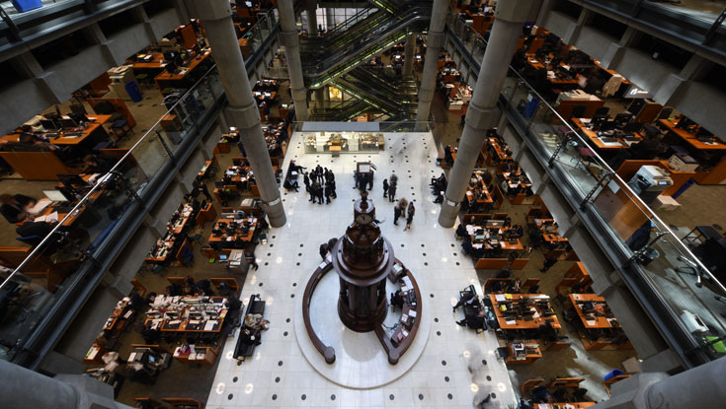
Lloyd's of London
What are Syndicates?
Syndicates – writing insurance.
A Lloyd’s syndicate is formed by one or more members joining together to provide capital and accept insurance risks.
Individual members are known as Names.
Most syndicates write a range of classes of business but many will have areas of specific expertise.
Syndicates are, technically, set up on an annual basis. In practice, they usually operate from year to year with members having the right, but not the obligation, to participate in syndicates the following year. This continuity of capital backing the syndicates means they function like permanent insurance operations.
Each syndicate sets its own appetite for risk, develops a business plan, arranges its reinsurance protection and manages its exposures and claims.
At 31 December 2019, there were 93 syndicates at Lloyd’s.
Members’ agents provide advice and administrative services to members, including assisting with syndicate selection.
At 31 December 2018, there were 3 members’ agents at Lloyd’s.
Notes:
Syndicates are the bodies that write the insurance and carry the risk. They are formed by members (names or corporate capital) who provide the underwriting capital. Prior to the market reconstruction in the 90’s a names liability was unlimited – Lloyd’s could take everything a name owned in order to cover losses.
We can see here the underwriting Room (The Room) at Lloyd’s and some of the boxes from which individual syndicates underwrite. Prior to the current pandemic underwriters were only allowed to underwrite in The Room
The number of syndicates at Lloyd’s has been declining. Once there were 3-400 syndicates. Now there are only 93.
It’s important to understand the difference between Syndicates and Managing Agents. The Syndicate provides the capital and underwrites i.e. is responsible for paying losses on the risks accepted by the Syndicate.

Slide 9




Underwriting
The role of the underwriter
The Underwriter performs a risk assessment on the submission presented by the broker determining; risk profile, loss history, geographical spread, total values at risk, maximum probable losses etc.
The Underwriter will review the policy wording (coverage) being sought by the broker and will either determine a price (premium) or confirm whether the premium required by the broker is acceptable.
The Lead Underwriter will confirm their acceptance of the risk by stamping and initialling the brokers slip below the line, indicating the percentage of risk they are willing to accept. The percentage is known as the written line.
Follow Underwriters will review the risk and confirm that the Lead Underwriter is acceptable to them before stamping and initialling the brokers slip below the line, indicating the percentage of risk that they are willing to accept.
The Underwriter will update internal systems and record the estimated premium amount for their percentage of the policy against the total premium amount the syndicate is allowed to write for the year.
Notes:
The role of the underwriter is a skilled job.
Each syndicate will have a Lead Underwriter who has ultimate underwriting authority for the syndicate.

Slide 10
Lloyd's of London
Who are Managing Agents and what do they do? (MGA)
Managing Agents – managing the syndicates.
A managing agent is a company set up to manage one or more syndicates on behalf of the members.
Managing agents have responsibility for employing underwriters, overseeing their underwriting and managing the infrastructure and day-to-day operations.
Whilst the syndicate members provide the capital to support the risks underwritten the managing agent undertakes the underwriting in accordance with the syndicate business plan.
Where a managing agent manages more than one syndicate each will be managed in accordance with it’s individual business plan.
At 31 December 2019, there were 54 managing agents at Lloyd’s.
Notes:
Managing Agents are companies that manage the day to day running of the Syndicate. They employ the staff that do the underwriting, provide the systems that are required to support underwriting and manage the day to day running of the Syndicate.
They can Manage one or more Syndicates. Typically if they manage more than one syndicate there is a relationship between the syndicates. For example the same capital providers supporting both Syndicates but each Syndicate underwrites different classes of business.

Slide 11
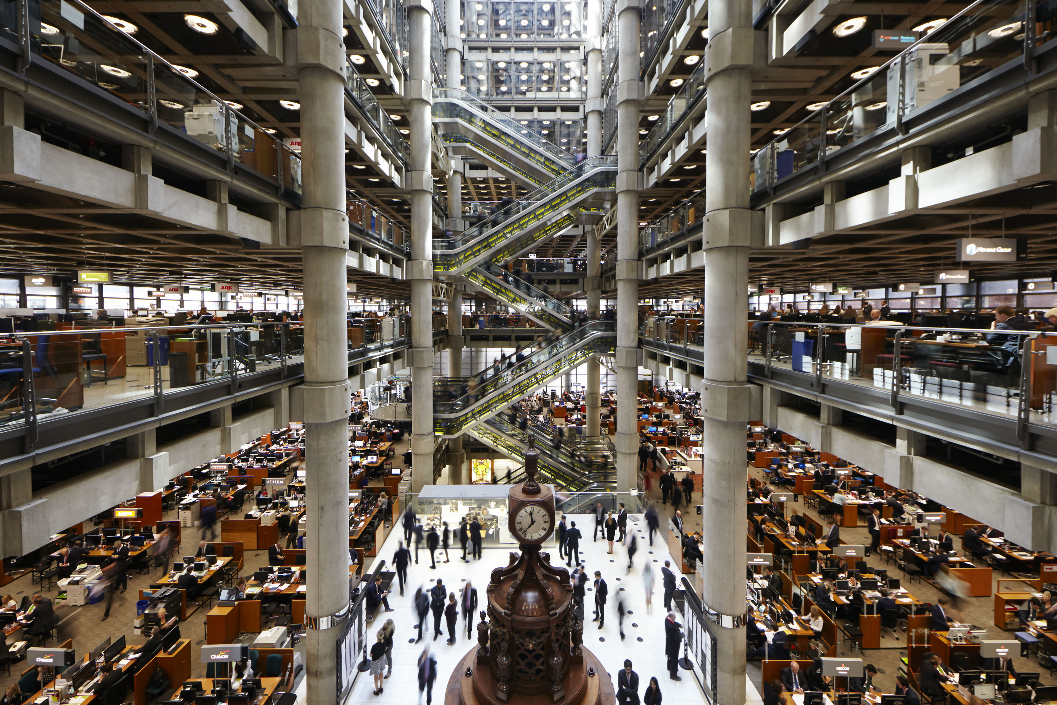
Lloyd's of London
Lets talk finance
Members – providing the capital.
All insurers need capital so where does the capital come from?
The capital to underwrite policies is provided by members of Lloyd’s. This capital is backed by
many of the world’s major insurance groups,
listed companies, individuals and limited partnerships, with corporate groups providing
the majority of the capital for the Lloyd’s market.
Members – Original members invested and
became Names on the syndicate. Liability was unlimited.
Corporate members were admitted in 1994 as Lloyd’s sought to inject fresh capital into the
market.
Most Names joined NameCo’s to gain the benefit of limited liability.
Notes:
Members provide the capital required to support the Syndicates underwriting operation. These members can be corporate entities or individuals (Names).
Names provided the original capital to the market and remember their liability was unlimited. In the event of significant losses Lloyd’s could take all their assets until their liability was satisfied. This caused significant hardship, bankruptcies and even suicides during the turmoil of the 80’s and 90’s.
Now corporate capital forms the majority of the finance underpinning Lloyd’s. Corporate capital enjoys limited liability as a result of which most names have moved their investment from personal investment to companies set up especially to facilitate individuals investing in Lloyd’s and gaining the benefits of limited liability.

Slide 12
Distribution Channels
How does Lloyd's get its business?
Insurance Brokers
Discussed in the next section
Coverholders
Service Companies
Coverholders – offering local access to Lloyd’s
A managing agent may also authorise third parties to accept insurance risks directly on behalf of its syndicates. These businesses, known as coverholders, form a vital distribution channel, offering a local route to Lloyd’s in many territories around the world.
Coverholders are provided with a delegated authority by the Managing Agent which specifies what types of insurance they can accept on the Managing Agents behalf, what terms and wordings they must apply and how claims are to be handled. The details of how covers are notified back to the managing agent are also clearly specified.
At 31 December 2019 there were 3,950 approved coverholder office locations.
A service company operates like a coverholder but is a wholly owned subsidiary of either a managing agent or of a managing agent’s holding company and which is authorised to enter into contracts of insurance for members of its associated syndicate and/or associated insurance companies.
At 31 December 2019 there were 366 service companies at Lloyd’s, with the majority
in the UK and the US.
Notes:
Coverholders are companies that the managing agent has authorised to underwrite business on their behalf via a delegated authority. Typically referred to as “having the pen”. Each coverholder requires authorisation with Lloyd’s and a binder agreement details the risks they are allowed to accept and the appropriate terms. Coverholders notify the managing agent of the risks they have underwritten and the claims via a borderaux.
Service Companies are a bit like tied agents however they are owned by the managing agent. They offer insurance contracts that are backed by the by the managing agent/Syndicate and only that managing agent. They may offer specialist insurance that is not otherwise offered by the managing agent therefore providing the managing agent with a separate risk class outside it’s own activities.

Slide 13
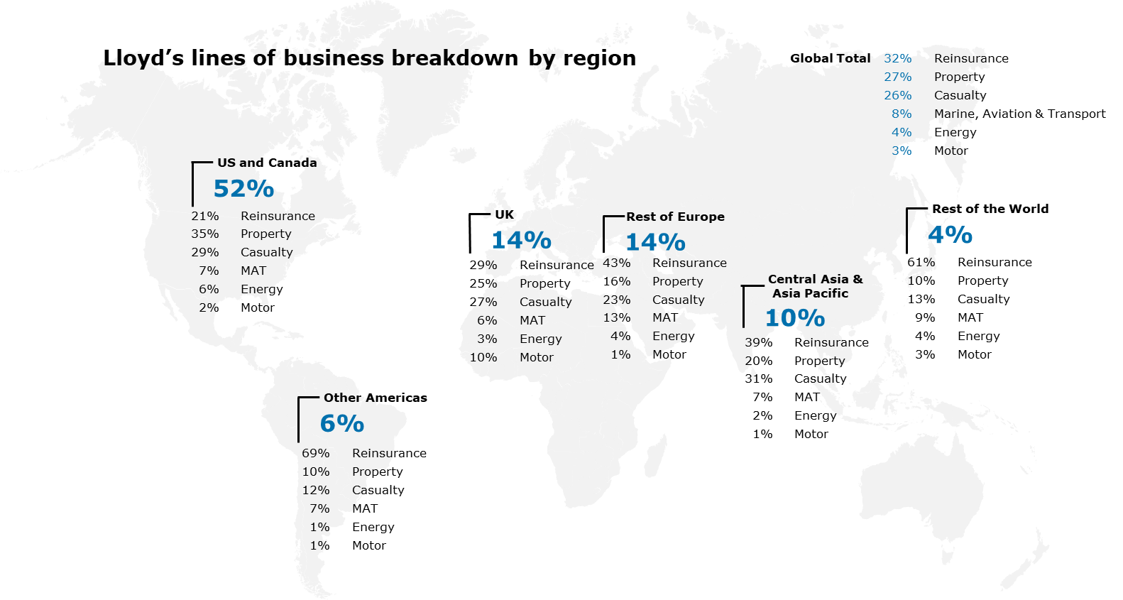
Lloyds of London
Statistics - 2019
Key figures:
Net resources £30.6bn
Solvency ratio 238%
Gross written premium £35.9bn
Gross claims paid £23.0bn
Combined ratio 102.1%
Return on capital 8.8%
Pre-tax financial result £2.5bn
Underwriting Result by Line of Business
Reinsurance | (£434m)
Property | £12m
Casualty | (£390m)
Marine, aviation & transport | (£199m)
Energy | £27m
Motor | £11m
Life | £1m
Notes:
Lloyd’s is a substantial insurance operation
It’s 2019 premium income was £35.9billion and it made a profit of £2.5bn
These are the aggregate figures for all syndicates operating within the market. Individual syndicates will have made profits or losses individually in accordance with their own performance.

Slide 14
Lloyds Brokers

Slide 15

Lloyds Brokers
What is a Lloyd’s Broker?
  A Lloyd’s broker acts as an authorised intermediary for their client
  (the buyer) who requires insurance coverage.
  To become a Lloyd’s broker, who is able to conduct business within this
  unique marketplace, a broking company must be:
    Approved and registered with Lloyd’s of London.
    Authorised and regulated by the Financial Conduct Authority and registered under a unique company number.
  Why become a Lloyd’s Broker?
    Provides immediate access to specialist decision-making underwriters ensuring answers to whether a risk can be placed are made quickly, enabling the broker to provide fast, high-value solutions.
    The market structure encourages innovation, speed and better value, making it attractive to policyholders and participants alike.
  Business at Lloyd’s is still carried out via face-to-face contact
    Although, the impact of electronic messaging and Covid-19 has started reduced this interaction.
    At 31 December 2019, there were 335 brokers at Lloyd’s - Many of which are London subsidiaries of the top ten major global broking groups such as Aon, Marsh, Willis Towers Watson, Arthur J. Gallagher, etc.

Slide 16

Lloyd’s Brokers
The Role of the Broker
  Using specialist market knowledge, a broker acts as intermediary between underwriters to:
    Negotiate insurance contracts to facilitate the risk transfer process between the policy holder and underwriters.
    Handle Claims, Accounting and Payment transaction processing
  Broker Must meet their clients demands in finding tailored solutions with the
  best rates available from the market.
    In this role, it is common that the Broker develops new products and modifies existing
    products to meet their client's demand.
  Offer effective administration, excellent client service and have a wide range
  of services to meet the client’s needs.
  Adapt to the changing business environment, often extending services to their clients to include:
    Risk management advice, analytics, claims consulting, captive management, risk financing, along with insurer credit and financial strength ratings ascertained from external sources and their own business dealings.
    One key service provided, includes claims handling by brokers for the advice and claims settlement processes.
    It was not unusual to see claims brokers walking round the market with suitcases of claims files to negotiate with individual underwriters. This process has largely been replaced by ECF (Electronic Claim File).
Broker receives a commission or set fee based on the insurance premium as compensation for their work.
Notes:
Using specialist market knowledge, act as intermediary between underwriters to:
Negotiate insurance contracts to facilitate the risk transfer process between the policy holder and underwriters. For larger, complex risks, this can involve the placement of the risk with more than one underwriter
Handle Accounting and payment transaction processing
Must meet their clients demands in finding tailored solutions with the best
rates available from the market.
In this role, it is common that the Broker develops new products and modifies existing
products to meet their client's demand.
Offer effective administration, excellent client service and have a wide spread
of services to meet the client’s needs.
Adapt to the changing business environment often extending services to their clients to include risk management advice, analytics, claims consulting, captive management, risk financing, along with insurer credit and financial strength ratings ascertained from external sources and their own business dealings.
One key service provided includes claims handling by brokers for the advice and claims settlement processes.
It was not unusual to see claims brokers walking round the market with suitcases of claims files to negotiate with individual underwriters. This process has largely been replaced by ECF (Electronic Claim File).
Broker receives a commission or set fee based on the insurance premium as compensation for their work

Slide 17





Lloyd’s Brokers
Risk Placement Process
Client approaches Broker with enquiry for risk coverage
Broker selects lead Underwriter who is well respected among other underwriting companies and at Lloyd’s for the type of business they want to place.
Lead Underwriter quotes the premium rate along with terms and conditions for coverage sought.
Broker returns to client for agreement of the conditions negotiated between the lead Underwriter
and the Broker.
With the client’s agreement to purchase coverage, the Broker presents the contract to other insurers for support until 100% of the cover is placed.
When placing is completed the Broker produces the policies, invoices and accounting documentation. In addition to this the Broker also handles premium collection, endorsements for changes in the cover, claims handling and collection of claim payments and so on.
Notes:
Client approaches Broker with enquiry for coverage
Broker selects a lead Underwriter who is well respected among other underwriting companies and at Lloyd’s for the type of business they want to place.
Lead Underwriter quotes the premium rate along with terms and conditions for coverage sought.
- It is common that the lead Underwriter also assumes the largest portion of the risk.
Broker returns to client for agreement of the conditions negotiated between the lead Underwriter and the Broker.
With the client’s agreement to purchase coverage, the Broker presents the contract to other insurers for support until 100% of the cover is placed.
- The risk placement might be shared with other London markets companies, who have offices located within the square mile of Lloyd’s and other overseas markets.
- This usually occurs if risk is too large for a single market or there are difficulties in finding capacity for the agreed terms and conditions in London.
When placing is completed the Broker produces the policies, invoices and accounting documentation. In addition to this the Broker also handles premium collection, endorsements for changes in the cover, claims handling and collection of claim payments and so on.
- Alternative placing methods to the above are offered and would include underwriters quoting to a broker for their own share of the coverage being afforded to the client.

Slide 18
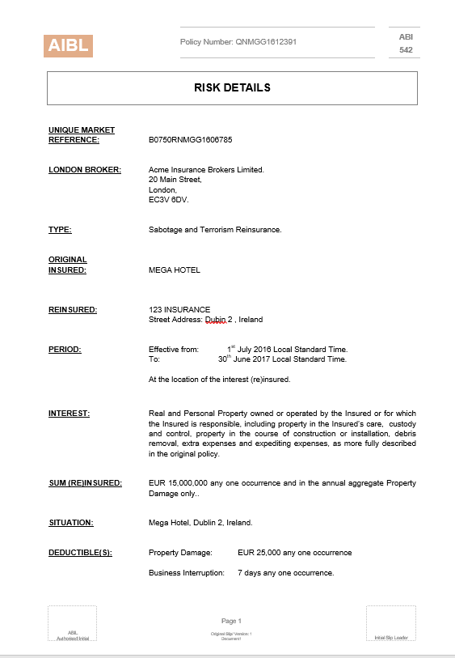
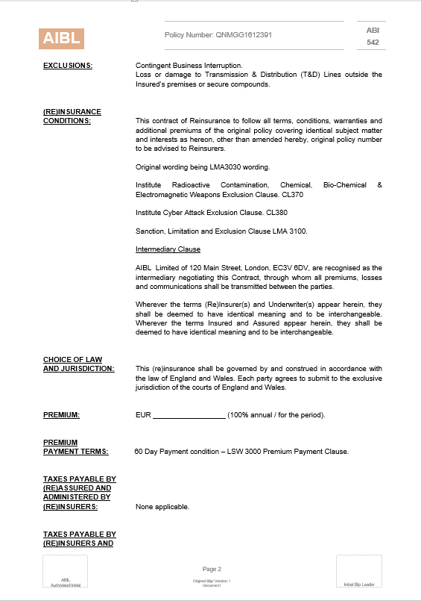

Let’s see an example placement process in action
ACME INSURANCE BROKERS LIMITED
Broker meets with Leading Underwriter to negotiate best quote for terms & conditions for proposed contract
Client agrees to purchase proposed coverage
“Contract “
Otherwise
known as:
Placing Slip
Leading
Underwriter
7,750,000
TAF 22 / 2/ 15

Slide 19




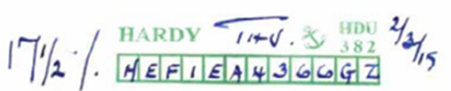

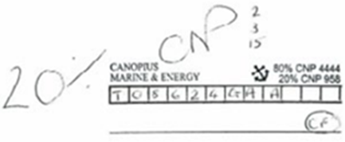

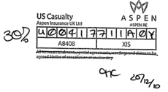
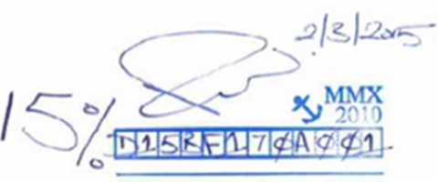
Placement process example
ACME INSURANCE BROKERS LIMITED
Broker meets with Leading Underwriter and negotiates best quote for terms & conditions for proposed contract
Client agrees to purchase proposed coverage
Broker presents Placing slip to Lead Underwriter to bind agreed percentage share of contract
Broker then seeks support from following market underwriters until percentages equals or exceeds 100%
Leading
Underwriter
Leading Underwriter

Slide 20
London Market Underwriting

Slide 21
London Market Underwriting
In addition to the Lloyds of London market there is a strong London corporate insurance market outside of Lloyd's and within the square mile.
Many UK domestic and foreign insurers have a presence in London with the objective of underwriting large risks. Some of this appetite is driven by the need for them to be able to support their large commercial clients in all the territories in which they trade. Typically, they set up dedicated business units to underwrite and accept these risks.
With the introduction of Corporate Capital at Lloyd's several corporate insurers have set up their own Managing Agents and Syndicates to trade within Lloyd's. Other insurers have a presence in the London Underwriting Centre (LUC) from where they underwrite outside the Lloyd's market. Some insurers even have a presence in both Lloyd's and the LUC.
Since the end of 2015, the LUC has been located at One Minster Court, London. Having all the underwriting companies in one place facilitates brokers in the placement of subscription risks since all the underwriters are in the one building.
Notes:
Outside of Lloyd’s there is a significant presence of insurance companies willing to underwrite large commercial and international business. Many of these companies are names that will be familiar as domestic insurers. Having a separate London Market insurance company allows them to participate in the large commercial market whilst isolating their performance from the domestic operation.
Since the opening of the Lloyd’s market to corporate investors and corporate owned syndicates, some companies now have operations both within Lloyd’s and in the London market – the London Underwriting Centre. In this event the Lloyd’s presence generally supports the underwriting of specialist lines of business.

Slide 22
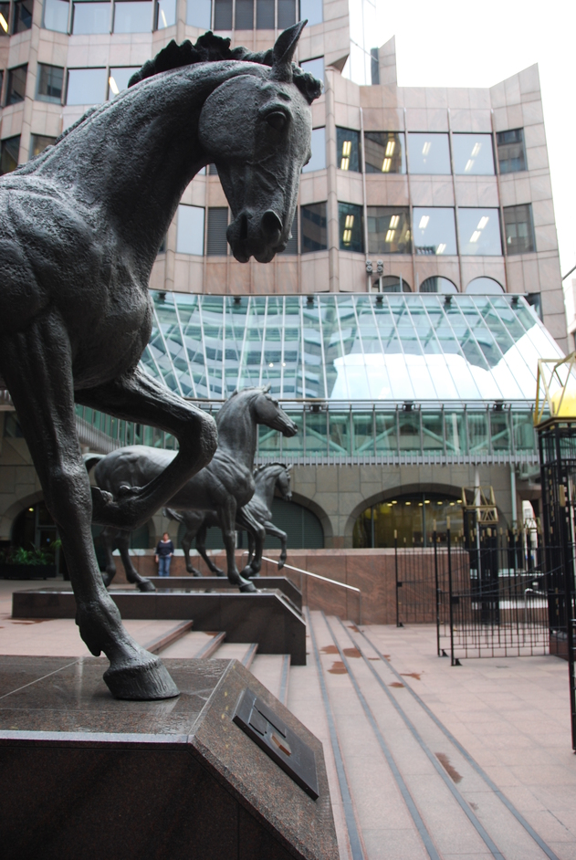
The International Underwriting Association of London
(IUA)
The International Underwriting Association of London (IUA) is the focal representative and market organisation for non-Lloyd’s international and wholesale insurance and reinsurance companies operating in the London Market.
The IUA is situate at One Minster Court London, the same building that houses the London Underwriting Centre.
The IUA was formed on 31 December 1998, through the merger of the London International Insurance and Reinsurance Market Association (LIRMA) and the Institute of London Underwriters (ILU). This union brought together the representative bodies for the marine and non-marine sectors of the London company insurance market.
The ILU's history in the marine, aviation and transport insurance markets dates back to 1884. Senior members of marine insurance companies had, since the 1850s, been meeting informally in the Jerusalem Coffee House and the Jamaica Wine Rooms near the Royal Exchange to discuss policy wordings and other matters of mutual interest. A proposal was made to establish a formal representative underwriting association in July 1882 and two years later the new ILU took up offices in the Royal Exchange Buildings.
The IUA promotes the design and implementation of all aspects of market modernisation, including process reforms and electronic interfaces across the market. This includes working on new processes for placing, claims and accounting and settlement using ACORD standards as the preferred format for data, in conjunction with leading organisation in the market.
Notes:
The International Underwriting Association is the trade body for the London Market insurers. Situate at One Minster Court they are within the same building as the London Underwriting Centre and are less than a mile from Lloyd’s.
Since there are many common back office functions that are similar to those at Lloyd’s (and are outsourced to the same company that Lloyd’s use) it’s important to have a trade body that can represent the market as a whole.
Interestingly the history of corporate underwriters getting together also dates back to a coffee house. Back in the 1850’s senior members of the marine insurance companies had been getting together in the Jerusalem coffee house. The Institute of London Underwriters was formed in 1884 and became the IUA with it’s merger with the London International Insurance and Reinsurance Market Association in 1998.

Slide 23
IUA Ordinary Members
Total of 65 Ordinary Members
AIG UK | Fidelis Underwriting Limited | Norwegian Hull Club
Allianz Global Corporate Specialty SE | Gard Marine and Energy Europe AS | Qatar Reinsurance Company Limited
Allied World Assurance Company (Europe) DAC | General Insurance Corporation of India (GIC Re- UK London Branch) | QBE Insurance (Europe) Ltd
Arch Insurance Company (Europe) Limited | General Reinsurance Company | Renaissance Re Europe AG, UK Branch
Aspen Insurance UK Limited | Global Aerospace Underwriting Managers (GAUM) | Royal & Sun Alliance Insurance Plc
Assicurazioni Generali S.p.A. (UK Branch) | Great Lakes Insurance SE (UK Branch – a Munich Re company) | RSA Luxembourg S.A.
Assuranceforeningen Skuld (Gjensidig) UK Branch | Hannover Rueck SE | SCOR UK Company Limited
Astaara Company Limited | HDI Global SE – UK | Sirius International Insurance Corporation (publ)
Aviva Insurance Limited | HDI Global Specialty SE | Sovereign Risk Insurance Ltd
AXA XL | Helvetia Insurance Company | Starr International (Europe) Limited
Axis Specialty Europe Plc | Houston Casualty Company London | Starstone Insurance SE
Barents Reinsurance SA | HSB Engineering Insurance Limited | Swiss Re Europe S.A, UK Branch
Berkley Re UK Limited | International General Insurance Co Ltd (Bermuda) | Swiss Re International SE
Berkley Offshore Underwriting Managers | International General Insurance Company (UK) Ltd | The Hartford
Chaucer Insurance Company DAC | Korean Reinsurance Company | The North of England P&I Association Ltd
Chubb European Group SE | La Reunion Aerienne London Ltd | Tokio Marine Kiln Insurance Limited
CNA Insurance Company Limited | Lancashire Insurance Company (UK) Limited | TransAtlantic Reinsurance Company
Convex Insurance UK Limited | Liberty Mutual Insurance Europe SE | Trans Re London Limited
Endurance Worldwide Insurance Limited | Markel Insurance SE | Travelers Insurance Company
Euler Hermes UK | Markel International Insurance Company Limited | UNIQA Osterreich Versicherungen AG
Everest Insurance (Ireland) DAC | MS Amlin Insurance SE | Zurich Insurance Plc
Everest Reinsurance (Bermuda) Ltd | New India Assurance Company Limited
Notes:
Current IUA Membership list.

Slide 24
Appendix

Slide 25
Useful Links
Lloyds of London
Lloyd's Website | www.Lloyds.com
Lloyd's Room Plan | https://www.lloyds.com/ukbuildingservices/ Select “Navigating the room 2020
Lloyd's Market Association | www.lmalloyds.com The LMA provides representation, information and technical services to underwriting businesses in the Lloyd's market.
Lloyds Register | www.lr.org Lloyd's Register provides information on surveys, inspections, construction and classification, issues related to ISO Standards and some historical shipping records.
London Market Insurance Brokers Committee (LMBC) | www.lmbc.co.uk LMBC is a trade body representing the interests of Lloyd's brokers operating in the London and worldwide insurance and reinsurance markets.
Guildhall Library | https://www.cityoflondon.gov.uk/things-to-do/history-and-heritage/guildhall-library The library contains all Lloyd's shipping records prior to 1985, plus other historical records.
Lets Talk Business | https://www.youtube.com/c/LetsTalkBusiness/videos 60 videos covering aspects of Lloyds, the Lloyds Market and Lloyds Processing

Slide 26
Useful Links
London Market
LMA guide to Claims | https://www.lmalloyds.com/CMDownload.aspx?ContentKey=2e172ce9-5883-4f57-b63a-ee710bae95a9&ContentItemKey=1b2259c9-6952-4718-bed2-219c6ebbc103
IUA | www.iua.co.uk
IUA Annual Review | https://www.iua.co.uk/IUA_Member/Publications/annual_report_home.aspx
LIIBA (London & International Insurance Brokers Association) | www.liiba.co.uk
LMG (London Market Group) | https://lmg.london/
LMG – London Matters 2020 Report | https://lmg.london/london-matters-2020-report/
LMG – London Matters 2017 Report | https://lmg.london/document/london-matters-2017/
Others
Chartered Insurance Institute | https://www.cii.co.uk/learning/qualifications/certificate-in-london-market-insurance-qualification/ Certificate in London Market Insurance
Association of British Insurers | www.abi.org.uk
Xchanging | www.dcx.technology XIS/XCS are responsible for Lloyd's market processing.
ECF | https://www.ecfinfo.com/training/about/what-is-ecf/ Explanation of ECF and the ECF process flow
TMEL | https://www.lmalloyds.com/LMA/Market_Processes/TMEL.aspx

Slide 27
DXC (Xchanging)
Undertakes back office processing for Lloyds including messaging
In 2001 Lloyd's and the International Underwriting Association (IUA) created partnerships with Xchanging for the backoffice processing of policy and claims services.
Xchanging Ins-sure Services (XIS) saw the creation of a single "bureau" for both the Lloyd's and companies markets for premium and policy processing services.
Xchanging Claims Service (XCS) provides claims services processing services for the Lloyd's Market.
In 2016, Xchanging was acquired by CSC. In 2017, CSC merged with HP Enterprise Services to form DXC Technology.

Slide 28
Electronic Messaging
Common electronic messaging abbreviations that you will come across in the market and with which you should be familiar
Message | Abbreviation
Underwriters Signing Message | USM
Syndicate Claims Message The SCM is an electronic message of claim advices transmitted via the London Insurance Market Network (LIMNet) or via the Lloyd’s Insurance Network (LIN). | SCM
London Insurance Market Claim Movement The London Insurance Market Claims Message (LIMCLM) is a standard format for the transmission of claims advices and settlements via Information Exchange facilities within LIMNet | LIMCLIM
London Premium Advise Note All Accounting and Settlement (A&S) premium entries submitted to Xchanging must be accompanies with a London Premium Advise Note. This applies to both Lloyd’s and Company underwriters | LPAN
Electronic Claim File The Electronic Claim File (ECF) is the combination of the Insurers’ Market Repository (IMR) and the Claims Loss Advice and Settlement System (CLASS). It enables carriers to review and respond to claim documents, claim data and claim financials in an electronic format. | ECF/ECF2
Claims Loss Advice and Settlement System Used by brokers to create new, and update existing, claim records with data and financials supplied by the client. | CLASS
Insurer’s Market Repository The Insurers’ Market Repository (IMR) is a document library allowing claim and policy documentation to be stored and linked back to policy and claim records created by the broker. | IMR
The Message Exchange Ltd Owns and operates The Exchange, the messaging hub that supports the sending and receiving of ACORD standard data messages between counterparties in the London insurance market. | TMEL
To be updated

Slide 29

Question Time
Any Questions?

Slide 30
Lloyd’s lines of business breakdown by region
Global Total
32% | Reinsurance
27% | Property
26% | Casualty
8% | Marine, Aviation & Transport
4% | Energy
3% | Motor
US and Canada
52%
UK
Rest of the World
21% | Reinsurance
35% | Property
29% | Casualty
7% | MAT
6% | Energy
2% | Motor
Rest of Europe
4%
14%
14%
29% | Reinsurance
25% | Property
27% | Casualty
6% | MAT
3% | Energy
10% | Motor
43% | Reinsurance
16% | Property
23% | Casualty
13% | MAT
4% | Energy
1% | Motor
Central Asia &
Asia Pacific
61% | Reinsurance
10% | Property
13% | Casualty
9% | MAT
4% | Energy
3% | Motor
10%
39% | Reinsurance
20% | Property
31% | Casualty
7% | MAT
2% | Energy
1% | Motor
Other Americas
6%
69% | Reinsurance
10% | Property
12% | Casualty
7% | MAT
1% | Energy
1% | Motor

